Slide 1
DS 4300
NoSQL &
KV DBs
Mark Fontenot, PhD
Northeastern University
Some material used with permission from Dr. Rachlin, with thanks!

Slide 2
Distributed DBs and ACID - Pessimistic Concurrency
ACID transactions
Focuses on “data safety”
considered a pessimistic concurrency model because it assumes one transaction has to protect itself from other transactions
IOW, it assumes that if something can go wrong, it will.
Conflicts are prevented by locking resources until a transaction is complete (there are both read and write locks)
Write Lock Analogy → borrowing a book from a library… If you have it, no one else can.
See https://www.freecodecamp.org/news/how-databases-guarantee-isolation for more for a deeper dive.

Slide 3
Optimistic Concurrency
Transactions do not obtain locks on data when they read or write
Optimistic because it assumes conflicts are unlikely to occur
Even if there is a conflict, everything will still be OK.
But how?
Add last update timestamp and version number columns to every table… read them when changing. THEN, check at the end of transaction to see if any other transaction has caused them to be modified.

Slide 4
Optimistic Concurrency
Low Conflict Systems (backups, analytical dbs, etc.)
Read heavy systems
the conflicts that arise can be handled by rolling back and re-running a transaction that notices a conflict.
So, optimistic concurrency works well - allows for higher concurrency
High Conflict Systems
rolling back and rerunning transactions that encounter a conflict → less efficient
So, a locking scheme (pessimistic model) might be preferable

Slide 5
NoSQL
“NoSQL” first used in 1998 by Carlo Strozzi to describe his relational database system that did not use SQL.
More common, modern meaning is “Not Only SQL”
But, sometimes thought of as non-relational DBs
Idea originally developed, in part, as a response to processing unstructured web-based data.
https://www.dataversity.net/a-brief-history-of-non-relational-databases/

Slide 6
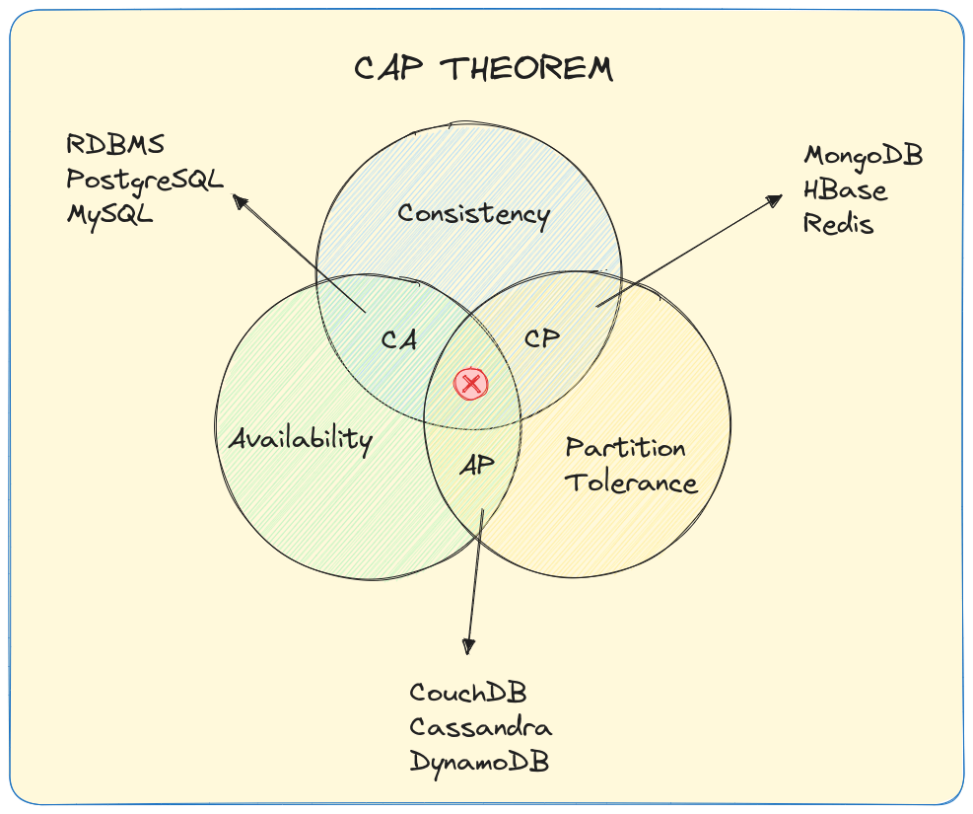
CAP Theorem Review
You can have 2, but not 3, of the following:
Consistency*: Every user of the DB has an identical view of the data at any given instant
Availability: In the event of a failure, the database system remains operational
Partition Tolerance: The database can maintain operations in the event of the network’s failing between two segments of the distributed system
* Note, the definition of Consistency in CAP is different from that of ACID.
Reference: https://alperenbayramoglu.com/posts/understanding-cap-theorem/

Slide 7
CAP Theorem Review
Consistency + Availability: System always responds with the latest data and every request gets a response, but may not be able to deal with network partitions
Consistency + Partition Tolerance: If system responds with data from the distrib. system, it is always the latest, else data request is dropped.
Availability + Partition Tolerance: System always sends are responds based on distributed store, but may not be the absolute latest data.
Reference: https://alperenbayramoglu.com/posts/understanding-cap-theorem/

Slide 8
ACID Alternative for Distrib Systems - BASE
Basically Available
Guarantees the availability of the data (per CAP), but response can be “failure”/“unreliable” because the data is in an inconsistent or changing state
System appears to work most of the time

Slide 9
ACID Alternative for Distrib Systems - BASE
Soft State - The state of the system could change over time, even w/o input. Changes could be result of eventual consistency.
Data stores don’t have to be write-consistent
Replicas don’t have to be mutually consistent

Slide 10
ACID Alternative for Distrib Systems - BASE
Eventual Consistency - The system will eventually become consistent
All writes will eventually stop so all nodes/replicas can be updated

Slide 11
Categories of NoSQL DBs - Review

Slide 12
First Up → Key-Value Databases

Slide 13
Key Value Stores
key = value
Key-value stores are designed around:
simplicity
the data model is extremely simple
comparatively, tables in a RDBMS are very complex.
lends itself to simple CRUD ops and API creation
Notes:
Value can be any arbitrary data (string, number, JSON object, binary object, etc)

Slide 14
Key Value Stores
key = value
Key-value stores are designed around:
speed
usually deployed as in-memory DB
retrieving a value given its key is typically a O(1) op b/c hash tables or similar data structs used under the hood
no concept of complex queries or joins… they slow things down
Notes:
Value can be any arbitrary data (string, number, JSON object, binary object, etc)

Slide 15
Key Value Stores
key = value
Key-value stores are designed around:
scalability
Horizontal Scaling is simple - add more nodes
Typically concerned with eventual consistency, meaning in a distributed environment, the only guarantee is that all nodes will eventually converge on the same value.
Notes:
Value can be any arbitrary data (string, number, JSON object, binary object, etc)

Slide 16
KV DS Use Cases
EDA/Experimentation Results Store
store intermediate results from data preprocessing and EDA
store experiment or testing (A/B) results w/o prod db
Feature Store
store frequently accessed feature → low-latency retrieval for model training and prediction
Model Monitoring
store key metrics about performance of model, for example, in real-time inferencing.

Slide 17
KV SWE Use Cases
Storing Session Information
everything about the current session can be stored via a single PUT or POST and retrieved with a single GET …. VERY Fast
User Profiles & Preferences
User info could be obtained with a single GET operation… language, TZ, product or UI preferences
Shopping Cart Data
Cart data is tied to the user
needs to be available across browsers, machines, sessions
Caching Layer:
In front of a disk-based database

Slide 18
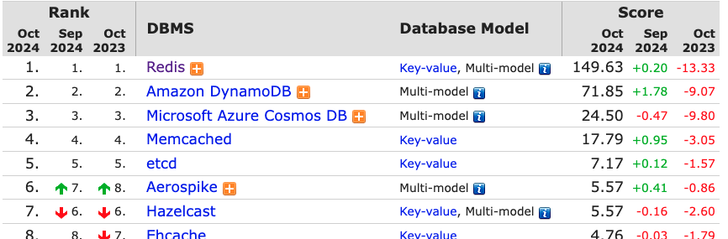
Redis DB
Redis (Remote Directory Server)
Open source, in-memory database
Sometimes called a data structure store
Primarily a KV store, but can be used with other models: Graph, Spatial, Full Text Search, Vector, Time Series
From db-engines.com Ranking of KV Stores:

Slide 19
Redis
It is considered an in-memory database system, but…
Supports durability of data by: a) essentially saving snapshots to disk at specific intervals or b) append-only file which is a journal of changes that can be used for roll-forward if there is a failure
Originally developed in 2009 in C++
Can be very fast … > 100,000 SET ops / second
Rich collection of commands
Does NOT handle complex data. No secondary indexes. Only supports lookup by Key.

Slide 20
Redis Data Types
Keys:
usually strings but can be any binary sequence
Values:
Strings
Lists (linked lists)
Sets (unique unsorted string elements)
Sorted Sets
Hashes (string → string)
Geospatial data

Slide 21
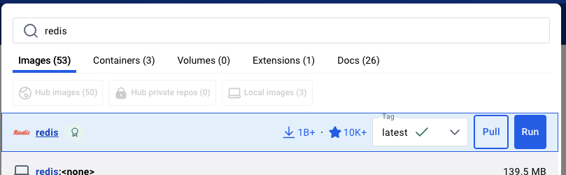
Setting Up Redis
in Docker
In Docker Desktop, search for Redis.
Pull/Run the latest image (see above)
Optional Settings: add 6379 to Ports to expose that port so we can connect to it.
Normally, you would not expose the Redis port for security reasons
If you did this in a prod environment, major security hole.
Notice, we didn’t set a password…

Slide 22
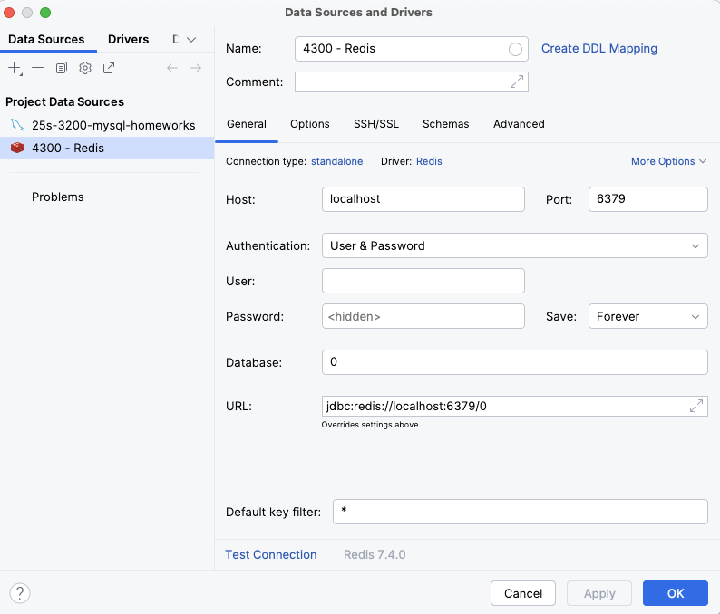
Connecting from DataGrip
File > New > Data Source > Redis
Give the Data Source a Name
Make sure the port is 6379
Test the connection ✅

Slide 23
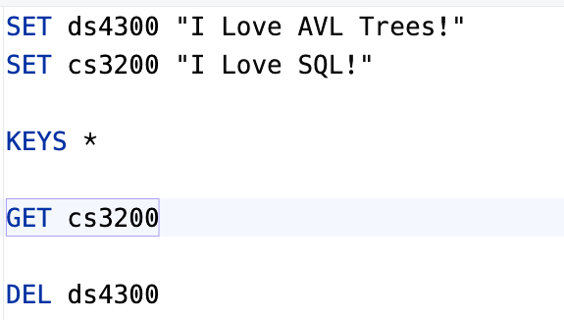
Redis Database and Interaction
Redis provides 16 databases by default
They are numbered 0 to 15
There is no other name associated
Direct interaction with Redis is through a set of commands related to setting and getting k/v pairs (and variations)
Many language libraries available as well.

Slide 24
Foundation Data Type - String
Sequence of bytes - text, serialized objects, bin arrays
Simplest data type
Maps a string to another string
Use Cases:
caching frequently accessed HTML/CSS/JS fragments
config settings, user settings info, token management
counting web page/app screen views OR rate limiting

Slide 25
Some Initial Basic Commands
SET /path/to/resource 0 SET user:1 “John Doe” GET /path/to/resource EXISTS user:1 DEL user:1 KEYS user*
SELECT 5
select a different database

Slide 26
Some Basic Commands
SET someValue 0 INCR someValue #increment by 1 INCRBY someValue 10 #increment by 10 DECR someValue #decrement by 1 DECRBY someValue 5 #decrement by 5
INCR parses the value as int and increments (or adds to value)
SETNX key value
only sets value to key if key does not already exist

Slide 27
Hash Type
Value of KV entry is a collection of field-value pairs
Use Cases:
Can be used to represent basic objects/structures
number of field/value pairs per hash is 2^32-1
practical limit: available system resources (e.g. memory)
Session information management
User/Event tracking (could include TTL)
Active Session Tracking (all sessions under one hash key)

Slide 28
Hash Commands
HSET bike:1 model Demios brand Ergonom price 1971
HGET bike:1 model
HGET bike:1 price
HGETALL bike:1
HMGET bike:1 model price weight
HINCRBY bike:1 price 100
What is returned?

Slide 29
List Type
Value of KV Pair is linked lists of string values
Use Cases:
implementation of stacks and queues
queue management & message passing queues (producer/consumer model)
logging systems (easy to keep in chronological order)
build social media streams/feeds
message history in a chat application
batch processing by queueing up a set of tasks to be executed sequentially at a later time

Slide 30
Linked Lists Crash Course
front
back
10
nil
Sequential data structure of linked nodes (instead of contiguously allocated memory)
Each node points to the next element of the list (except the last one - points to nil/null)
O(1) to insert new value at front or insert new value at end

Slide 31
List Commands - Queue
Queue-like Ops
LPUSH bikes:repairs bike:1
LPUSH bikes:repairs bike:2
RPOP bikes:repairs
RPOP biles:repairs

Slide 32
List Commands - Stack
Stack-like Ops
LPUSH bikes:repairs bike:1
LPUSH bikes:repairs bike:2
LPOP bikes:repairs
LPOP biles:repairs

Slide 33


List Commands - Others
LPUSH mylist “one”
LPUSH mylist “two”
LPUSH mylist “three”
Other List Ops
LLEN mylist
LRANGE <key> <start> <stop>
LRANGE mylist 0 3
LRANGE mylist 0 0
LRANGE mylist -2 -1

Slide 34
JSON Type
Full support of the JSON standard
Uses JSONPath syntax for parsing/navigating a JSON document
Internally, stored in binary in a tree-structure → fast access to sub elements

Slide 35
Set Type
Unordered collection of unique strings (members)
Use Cases:
track unique items (IP addresses visiting a site, page, screen)
primitive relation (set of all students in DS4300)
access control lists for users and permission structures
social network friends lists and/or group membership
Supports set operations!!

Slide 36
Set Commands
SADD ds4300 “Mark”
SADD ds4300 “Sam”
SADD cs3200 “Nick”
SADD cs3200 “Sam”
SISMEMBER ds4300 “Mark”
SISMEMBER ds4300 “Nick”
SCARD ds4300

Slide 37
Set Commands
SADD ds4300 “Mark”
SADD ds4300 “Sam”
SADD cs3200 “Nick”
SADD cs3200 “Sam”
SCARD ds4300
SINTER ds4300 cs3200
SDIFF ds4300 cs3200
SREM ds4300 “Mark”
SRANDMEMBER ds4300

Slide 38
??

